Slide 1
The transmission and detection of
preambles in PRACH

Slide 2
1
Preamble generation
2
Preamble Transmission
目
录
3
Preamble Detection
4
Summary and Experience

Slide 3
1
Preamble Generation

Slide 4
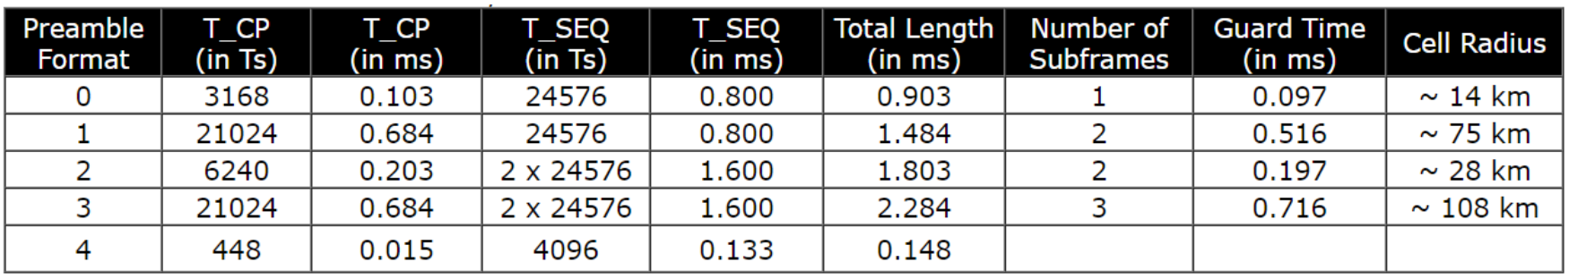

1
Preamble generation
Preamble generation
From the slides in class, we can see that there are four main types of Preamble signals supported for transmission on the PRACH channel, namely format_0, format_1, format_2, and format_3. The characteristics of these four Preamble signals are shown in the table below:

Slide 5
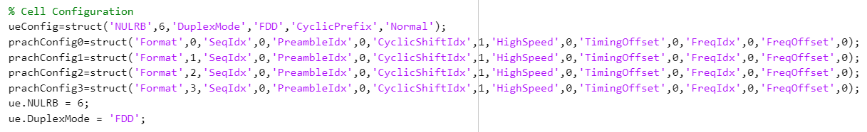
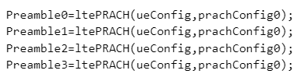
1
Preamble generation
Preamble generation
We used the toolkit in MATLAB to generate four pilot sequences, as shown in the following figure. In the next slide, we drew images of the four pilot sequences:

Slide 6
1
Preamble generation
Preamble generation
Format 0
Format 1
Format 2
Format 3

Slide 7
2
Preamble Transmission

Slide 8
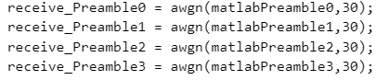
2
Preamble Transmission
Preamble Transmission
To simulate the actual transmission process, we add Gaussian white noise to the actual channel, where the signal-to-noise ratio is set to 30. The following is the matlab code for simulating AWGN channels, and next page is the pilot image after adding noise:
SNR = 30
Function from Matlab Toolbox

Slide 9
2
Preamble Transmission
Preamble Transmission
Format 0
Format 1
Format 2
Format 3

Slide 10
3
Preamble Detection

Slide 11
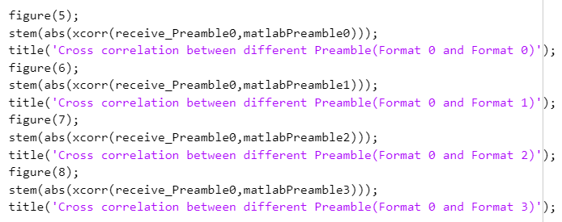
3
Preamble Detection
Preamble Detection
In the detection part of the pilot sequence, we will add Gaussian white noise to the pilot sequence and make cross correlation with the original four preamble respectively. We will analyze the pilot sequence at the transmitter by observing the image of the results of their cross correlation operations. Next, we will use the transmit format_ 0 preamble as an example:
Cross correlation operation at the receiver

Slide 12
3
Preamble Detection
Preamble Detection
Through observation, when the transmitting end emits a format_0 preamble, the received pilot and the format_0 original preamble are cross-correlated at the receiving end. The resulting graph is symmetrical on both sides, and the cross-correlation function has only one peak located at the center of the X-axis, indicating a high correlation between the two signals

Slide 13
3
Preamble Detection
Preamble Detection
Comparing the correlation functions between the transmission signal and the remaining three forms of preamble, we found that the amplitude map of the cross-correlation function is asymmetric , indicating that the two are not related and it can be determined that they are not the same preamble.

Slide 14
3
Preamble Detection
Preamble Detection
To verify the accuracy of our theory, we cross-correlated the results of the remaining three sets of pilots passing through the AWGN channel with their original signals. The results showed that these cross-correlation graphs were all symmetric, indicating that this verification method is feasible.

Slide 15
4
Summary and Experience

Slide 16
3
Summary and Experience
In this assignment, we first used the built-in toolkit of MATLAB to establish a four segment preamble sequence according to relevant standards. Then, we added noise to the four segment preamble sequence to simulate the actual transmission environment. At the receiving end, we performed cross correlation operations between the four segment preamble sequence of the simulated channel and the original sequence. If the amplitude map obtained is symmetrical and has a peak in the center of the image, we determine that it is the corresponding original preamble sequence.
Through this assignment, we have gained a deeper understanding of preamble sequences in PRACH channels and learned how to simulate preamble sequences using Matlab related tool packages.

Slide 17

Thanks for Listening !

